Slide 1
Welcome to 2022 -2023

Slide 2
School Timetable
The school gates open at 8:45am and the bell rings at 8:55am.
All children will enter from our Fournier Street entrance.
Schools ends at 3:30pm. All children must be collected from Fournier Street.
Please always inform the office if you child will not be attending or if you will be late collecting your child. You must also inform us before 3:00pm, if someone else will be collecting your child.

Slide 3
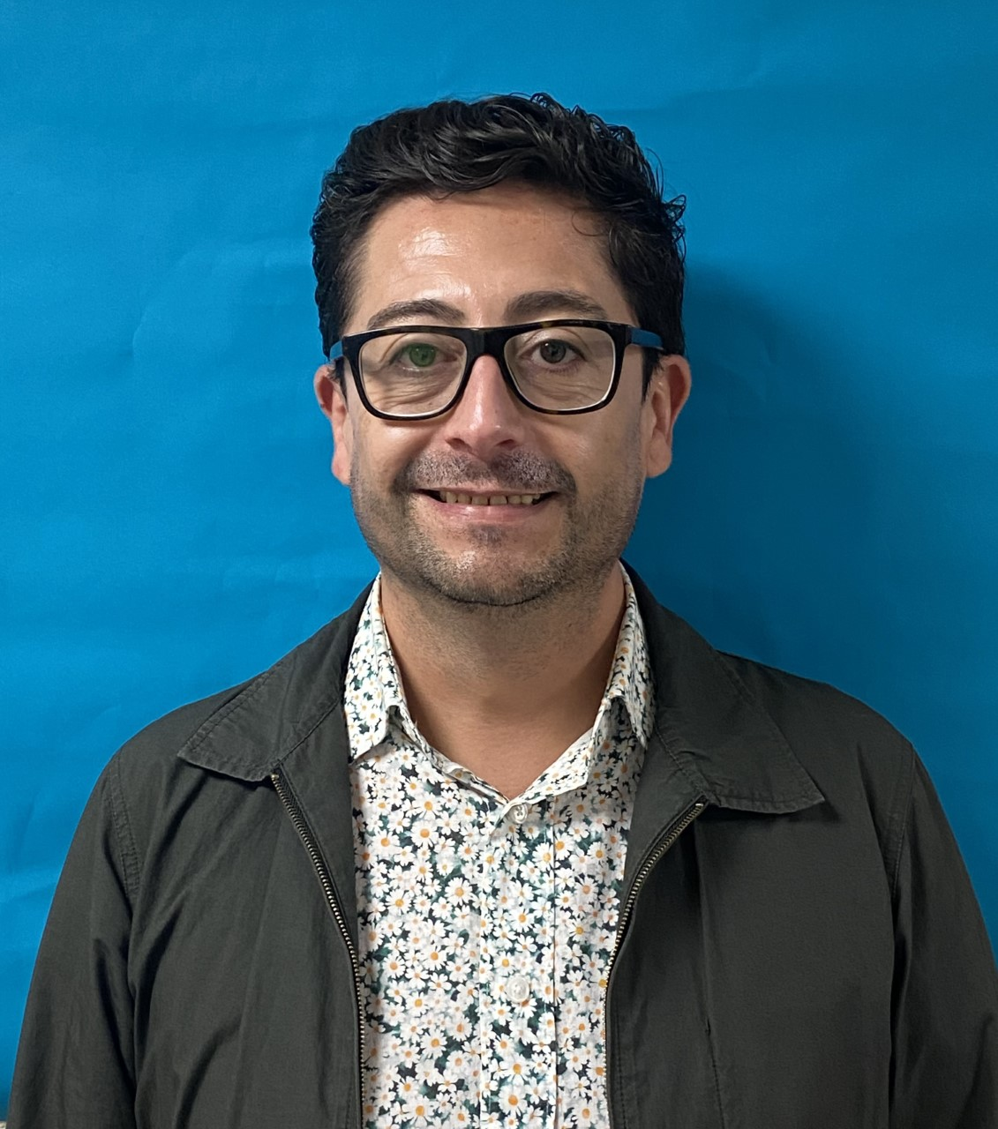
Spanish
Mr. Valenzuela teaches Spanish to all KS1 and KS2 children each Thursday.
Notes:
For years 1-6

Slide 4
Violins
Years 3 and 4 have violin lessons every Thursday. All children are given an instrument to play at school.
Where the violin teachers assesses a child to have a particular aptitude and engagement with learning a stringed instrument they will continue to have lessons each Thursday up to year 6.
Notes:
For Years 3-6 delete where appropriate

Slide 5
Wrap Around Care
Breakfast club: 8 – 9am
After school Provision: 3.30 – 5.45pm
We also offer a range of after school clubs for children to join; football, culture, drama, rich mix film, computing

Slide 6
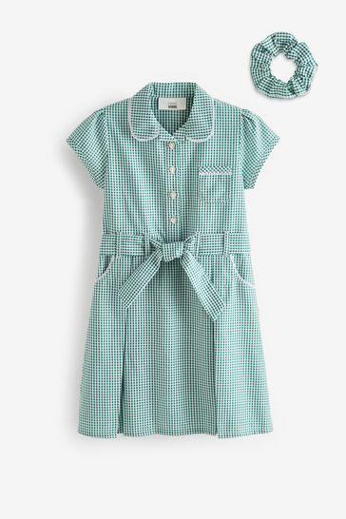
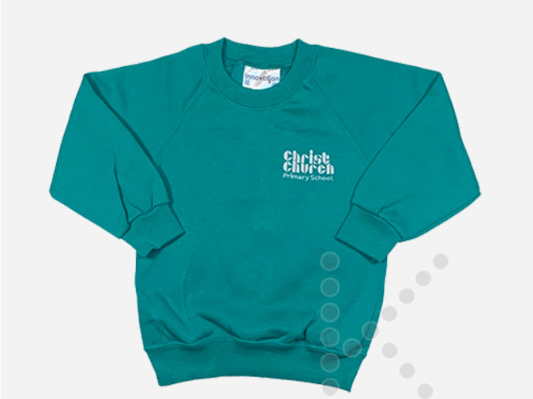
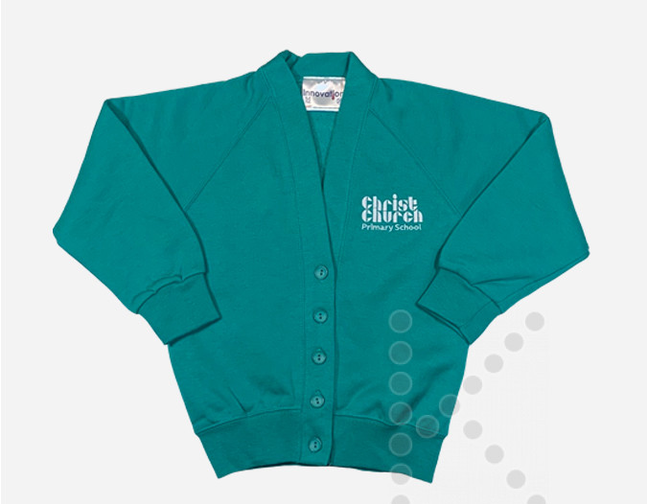
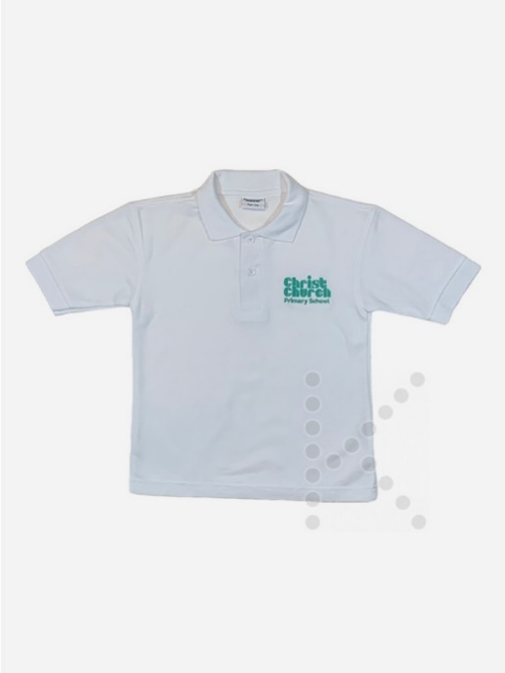
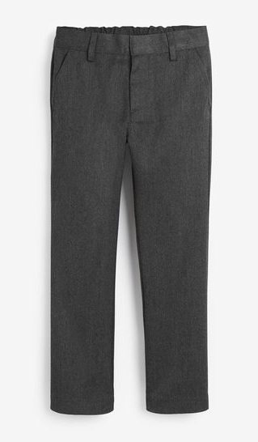
School Uniform Ocean Schoolwear, Watney Market

Slide 7
Uniform
Black shoes or trainers only
Jewellery should not be worn to school. Children may wear a simple wrist watch, but not fitbit, apple or other devices.
Long Hair should be tied back neatly
Don’t forget to LABEL your school uniforms!

Slide 8
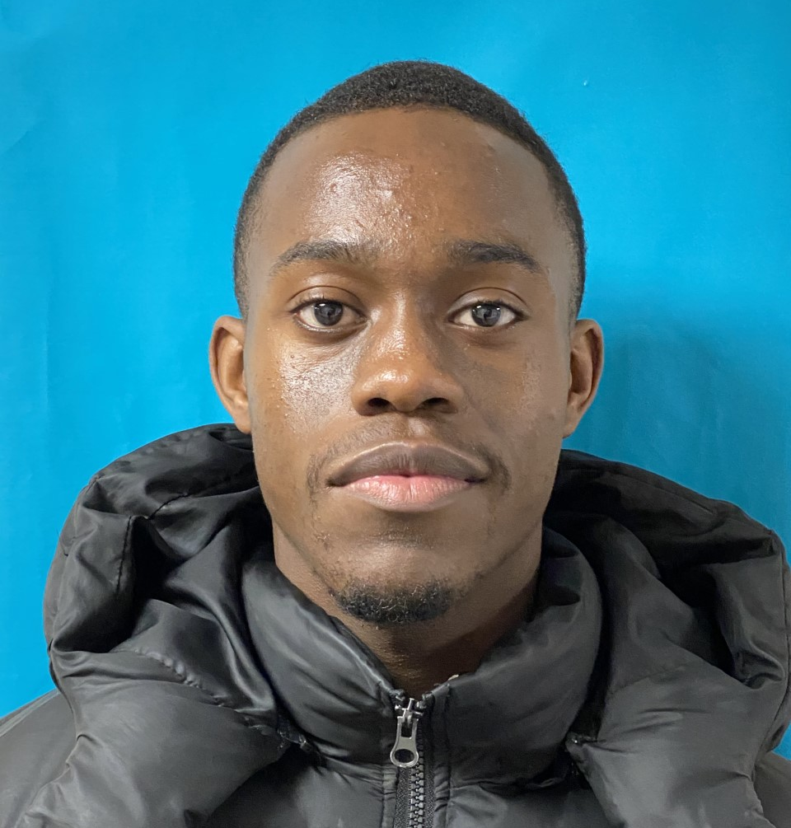
P.E.
Mr. Aileru, known as Coach Kenny teaches PE to all classes once each week. They will also have an additional session taught by the class teacher.
Children in year 5 and 6 will have a term of swimming lessons
P.E. Kits
House colour t-shirt
Black or dark grey shorts/tracksuit bottoms
Black or white Plimsolls/ trainers – no football or astroturf boots
Children wear their P.E. kits to school on their specified day.
Notes:
For years 1-6

Slide 9
Homework & Spellings
Homework will be given out daily or weekly, depending on need.
Spelling lists are sent home each week and the children will have a weekly test
All children should read every day. Please sign the reading record
PLEASE read for 10 minutes EVERYDAY or more!!

Slide 10
Medication
If your child needs medication or has an allergy, we must have a supporting doctor’s note.
Medications must be kept up-to-date.
Asthma pumps and Epi-pens are kept in class
If your child needs an asthma pump/ Epi-pen and does not have one at school, they will not be allowed to attend.

Slide 11
Time to Talk
If you have any concerns or would like to talk,
Please book an appointment by emailing the school office.

Slide 12
Parent Reps
The Parents and friends have a What's App network to share information and answer questions. If you are new to the school please ask for a connection to this helpful group.

